Slide 1
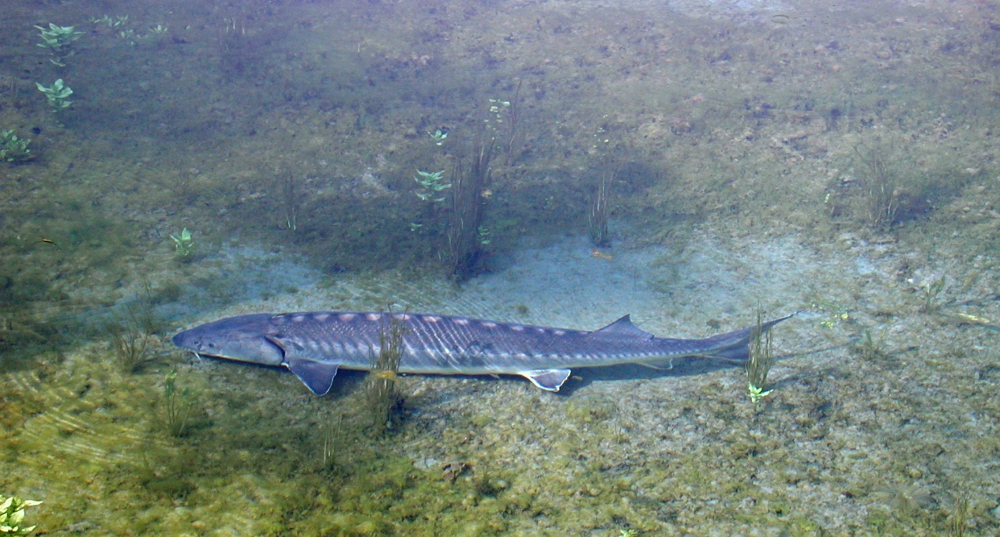
CONVEGNO FINALE
Andrea Casoni
Azione di conservazione su Acipenser naccarii

Slide 2
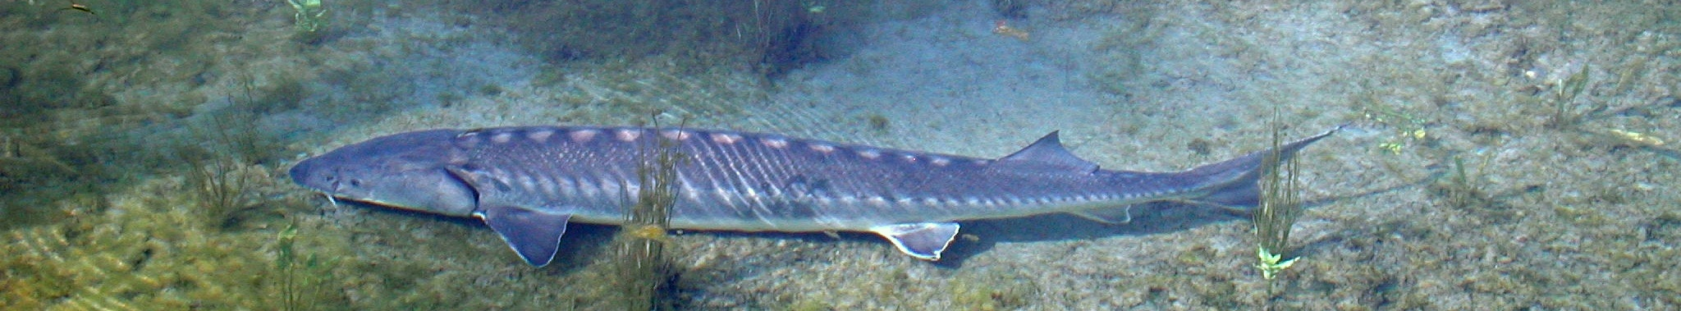

Target species: Acipenser naccarii*
Acipenser naccarii: now classified as Critically Endangered (Possibly Extinct) by IUCN. Endemic of Adriatic basin (last update, 2011). The project arises from evidences of natural reproduction only in the lower stretch of Ticino river, where a landlocked population was identified in 2009-2015. Meanwhile, in 2017, another LIFE Project (Con.Flu.Po) definitely defragmented the Po River at Isola Serafini Dam (the reason why the population was «landlocked»). Main threats to counter in the home range of the landlocked population:
Predation and competition by Silurus glanis, poaching;
2. Insufficient protection
NECESSARY ACTIONS:
A.3 - Proposal for establishing a new SAC for the protection of “Adriatic Sturgeon spawning sites”
A.5 - Consultations for the creation of a task force to protect Acipenser naccarii spawning site
E.2 – Sub-action E2.1 – Training of the task force volunteers
C.7 - Active defense of A. naccarii spawning sites
D.6 - Monitoring the efficacy of action C.7

Slide 3
A.3 Action - Proposal for establishing a new SAC for the protection of “Adriatic Sturgeon spawning sites”
Objectives
The main objective of the Action is to maintain in the long term the optimal status of conservation of this stretch of Ticino River as breeding site for the species, designating a Natura 2000 site ad hoc, focused on the conservation of A. naccarii
Expected results
The best strategy to counter Silurus glanis established.
The new proposed SCI characterized and described and all the technical necessary documents for the approval process of the new SAC prepared; the approval process engaged till the submission of the institution of the new SAC to the EC.
Milestones
Description | Foreseen Deadline | Actual deadline
Institution of the new proposed SAC "Adriatic Sturgeon spawning site" approved by Regione Lombardia and presented to MATTM | 12/2018 | 12/2020
Proposal of institution of the new SAC submitted by the MATTM to EC | 10/2020 | -
Deliverables
Description | Foreseen Deadline | Actual deadline
All the formal acts tracing the iter of approval faced | 12/2018 | 12/2020
Standard form of the proposed SAC | 12/2018 | 12/2020

Slide 4
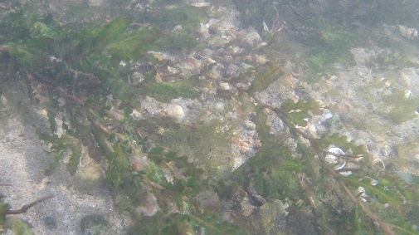
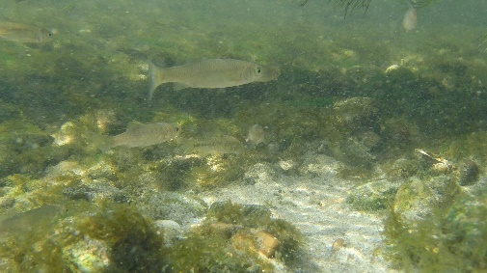
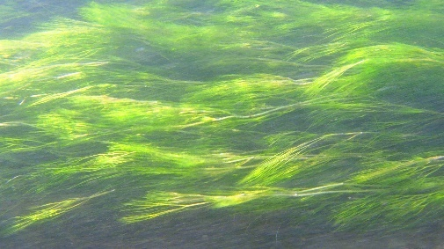
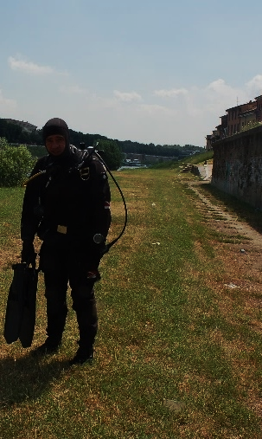
A.3 Action - Proposal for establishing a new SAC for the protection of “Adriatic Sturgeon spawning sites”
THE ACTION HAS BEEN EXECUTED IN 3 PHASES:
Improving the scientific knowledge of the site, through the collection of previous information and data and through a field campaign to collect new experimental data.
Foreseen: n. 20 nocturnal surveys aimed at the observation of breeding adults in nature
Actually performed: n. 9 nocturnal surveys (scuba diving) in the period 2017-2019, during the spawning season; more than 30 recognitions on the riverside in the two seasons.
Additional 14 nocturnal surveys performed in 2020 spawning season as direct observation with a spotlight.
SCUBA DIVING CAMPAIGNS in Ticino River:
03/08/2017 - Ponte Coperto (PV)
18/06/2019 – Ponte Coperto (PV)
18/06/2019 – at Roggia Vernavola confluence
25/06/2019 – Ponte Coperto (PV)
25/06/2019 – at Roggia Vernavola confluence
09/07/2019 - Ticino River at Travacò Siccomario
09/07/2019 - Ponte Coperto (PV)
12/07/2019 - Ponte Coperto (PV)
12/07/2019 - at the confluence of Ticino in the Po River
NOCTURNAL DIRECT OBSERVATIONS FROM THE BOAT WITH A SPOTLIGHT:
15/07/2020 | F. Ticino | Monte e valle ponte coperto Pavia
16/07/2020 | F. Ticino | Canarazzo – Pavia Ponte coperto
17/07/2020 | F. Ticino | Canarazzo – Pavia Ponte coperto
20/07/2020 | F. Ticino | Monte e valle ponte coperto Pavia
21/07/2020 | F. Ticino | Monte e valle ponte coperto Pavia
22/07/2020 | F. Ticino | Canarazzo – Pavia Ponte coperto
23/07/2020 | F. Ticino | Canarazzo – Pavia Ponte coperto
24/07/2020 | F. Ticino | Monte e valle ponte coperto Pavia
27/07/2020 | F. Ticino | Monte e valle ponte coperto Pavia
28/07/2020 | F. Ticino | Canarazzo – Pavia Ponte coperto
29/07/2020 | F. Ticino | Canarazzo – Pavia Ponte coperto
30/07/2020 | F. Ticino | Canarazzo – Pavia Ponte coperto

Slide 5
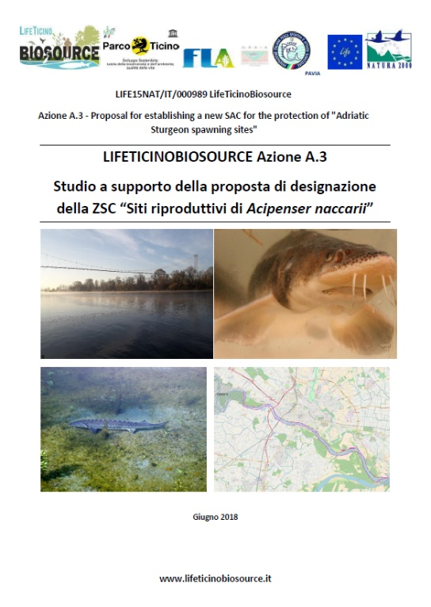

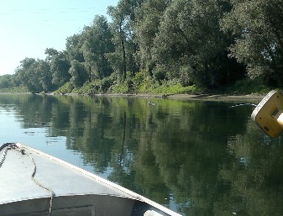
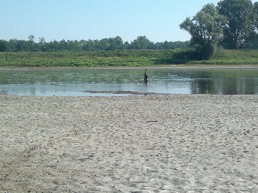
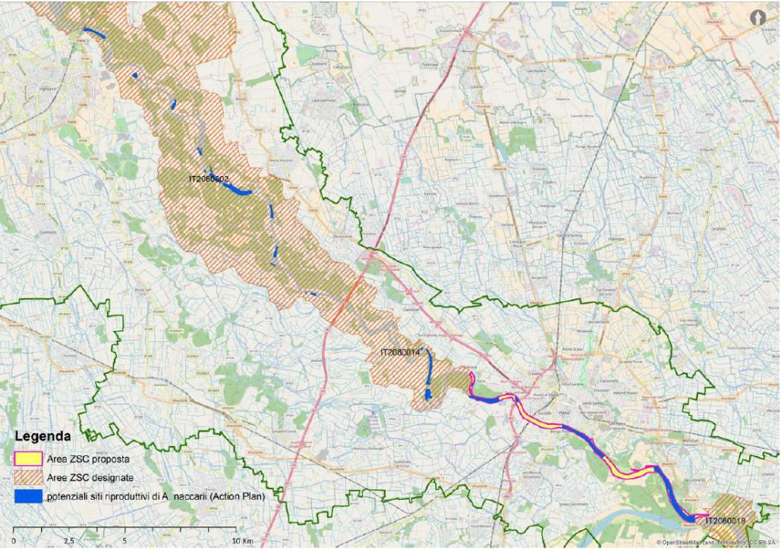
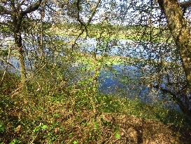
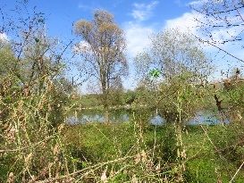
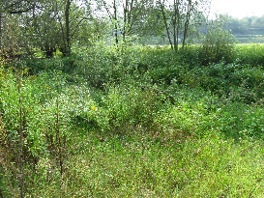
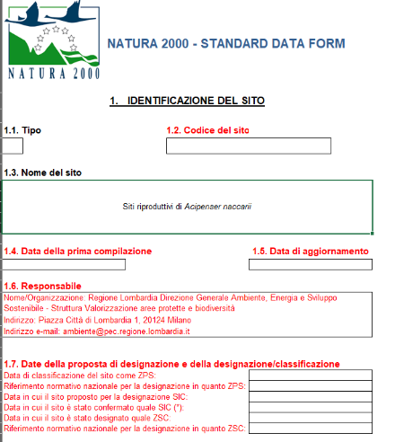
A.3 Action - Proposal for establishing a new SAC for the protection of “Adriatic Sturgeon spawning sites”
2) Preparation of the scientific and technical documents
- Collection of previous data
- Field surveys for the site habitat, environmental and hydraulic characterization, boundaries identification
June 2018

Slide 6
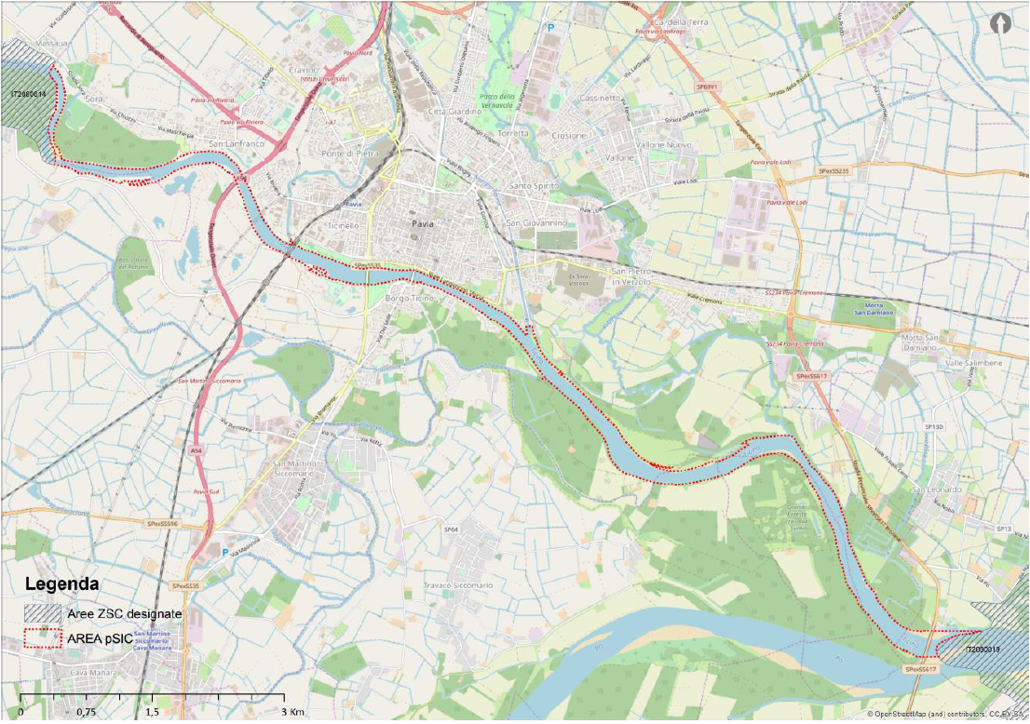
A.3 Action - Proposal for establishing a new SAC for the protection of “Adriatic Sturgeon spawning sites”
3) preparation of administrative and bureaucratic materials to be sent to Regione Lombardia for the designation of a new SCI and to the Ministry of the Environment for the designation of a new SAC.
March 2020
APPROVAZIONE DELLA CANDIDATURA A SITO DI IMPORTANZA
COMUNITARIA (PSIC) DEL SITO DENOMINATO “SITI RIPRODUTTIVI DI
STORIONE COBICE” NELL’ALVEO DEL FIUME TICINO IN PROVINCIA
DI PAVIA E TRASMISSIONE DELLA PRESENTE DELIBERAZIONE AL
MINISTERO DELL’AMBIENTE E DELLA TUTELA DEL TERRITORIO E DEL
MARE, PER I SEGUITI DI COMPETENZA
DGR del 23/3/2020 n.2972
December 2020
Approvazione del MATTM

Slide 7
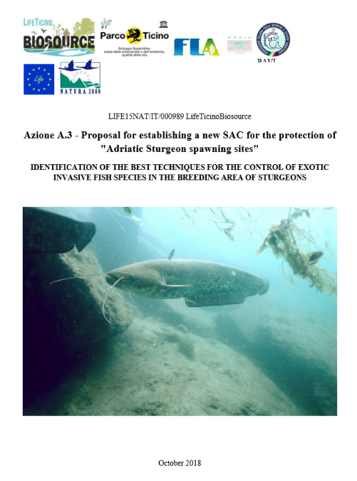
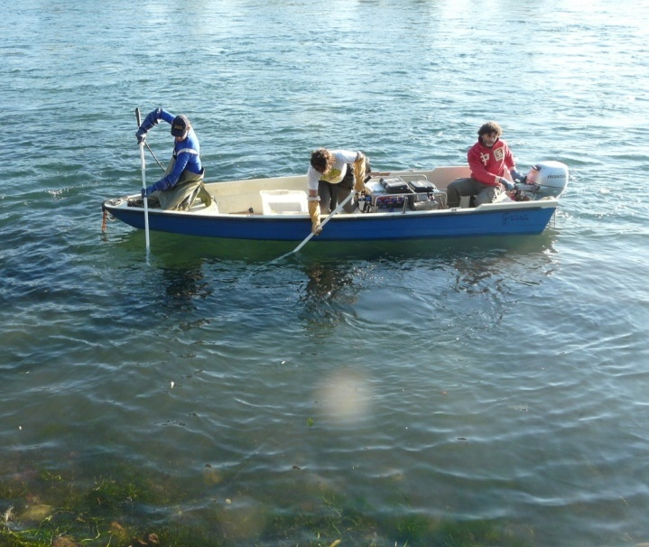
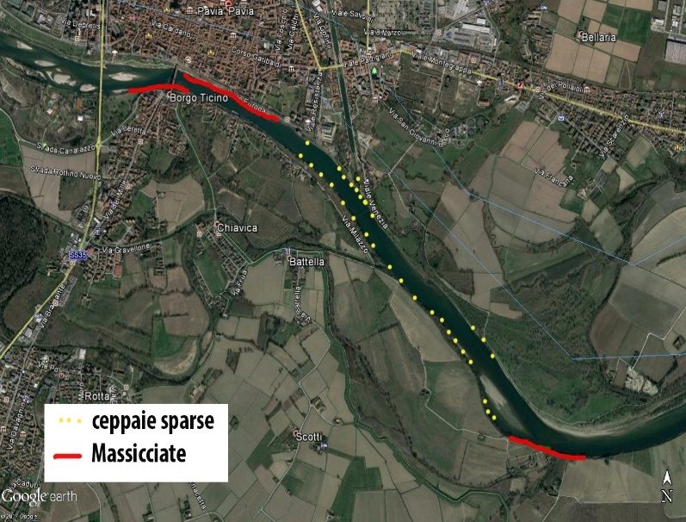
A.3 Action - Proposal for establishing a new SAC for the protection of “Adriatic Sturgeon spawning sites”
Defining the Containment Protocol of the species Silurus glanis
n. 10 electrofishing campaigns performed (as required from the GA) in and close to the spawning site of sturgeon, especially in and around the spawning season.
This activity finished in October 2018.
The containment protocol includes:
1. Identification of the hot-spots for the capture of S. glanis
2. Identification of the best strategy of capture: electrofishing performed by day
3. Timing of the activity
Date | Location
15/03/2017 | Foce Gravellone vecchio-confluenza Po - circa 5 km in sponda sinistra orografica e lanca in località Belvedere
06/06/2017 | Ponte Coperto-Foce Gravellone vecchio - circa 4 km in sponda sinistra orografica
15/06/2017 | Ponte Coperto-Foce Gravellone vecchio - circa 4 km in sponda destra orografica
15/06/2017 | Foce Gravellone vecchio-confluenza Po – circa 5 km in doppia sponda
21/07/2017 | Foce Gravellone vecchio-confluenza Po – ceppaie e massicciate in doppia sponda
03/08/2017 | Ponte Coperto-Foce Gravellone vecchio - ceppaie e massicciate in doppia sponda
15/11/2017 | Ponte Coperto-Foce Gravellone vecchio - ceppaie e massicciate in doppia sponda
22/11/2017 | Foce Gravellone vecchio-confluenza Po – ceppaie e massicciate in doppia sponda
13/12/2017 | Ponte Coperto-Foce Gravellone vecchio - ceppaie e massicciate in doppia sponda
13/12/2017 | Foce Gravellone vecchio-confluenza Po – ceppaie e massicciate in doppia sponda
Stumps
ballast

Slide 8
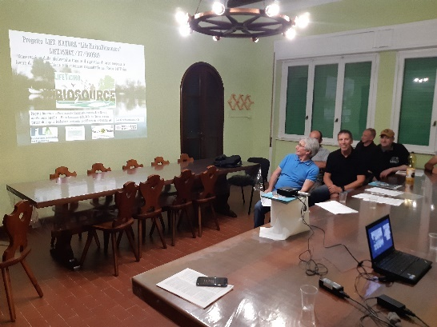
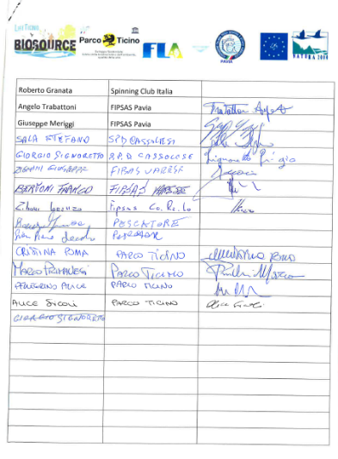
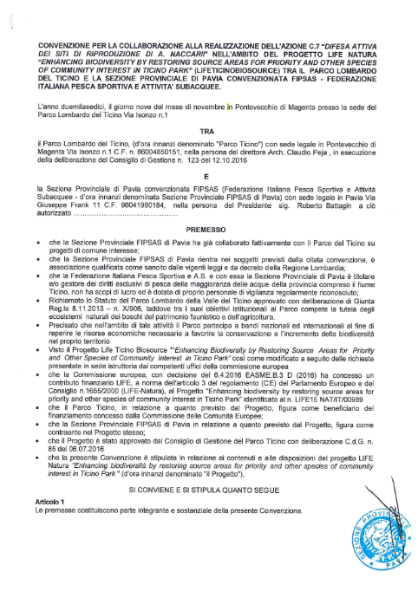
A.5 - Consultations for the creation of a task force to protect Acipenser naccarii spawning site
Objectives
The objective was to involve the local associations of anglers on the active defense of A. naccarii spawning site (target of Action A3 and C7) and also of Huso huso, after its reintroduction, before it takes the long way towards the sea, expecially against two main threats: IAS and poaching.
Expected results
The formal establishment of a task force, composed of a minimum of 10 volunteers, committing themselves to attend the course foreseen in Action E2 (Sub-action E2.1) and to participate to Action C7.
Involvement of FIPSAS Pavia, FIPSAS CO.RE.LO, SPS Bereguardo, SPD Cassolese, SPS Vigevano, Spinning Club Italia, FIPSAS Varese (potential total audience of more than 1,000 anglers).
More than a hundred people attended the 5 evening events (one more than expected) held in Bereguardo on 23/01/2017, 21/02/2017, 14/03/2017, 28/03/2017 and 28/04/2017
Deliverables
Description | Foreseen Deadline | Actual deadline
Task Force establishment formal act | 06/2017 | 06/2017

Slide 9
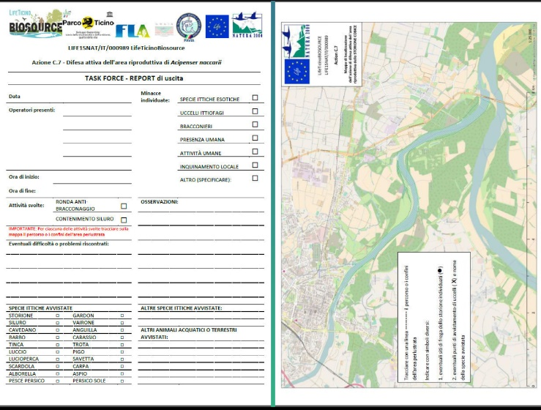
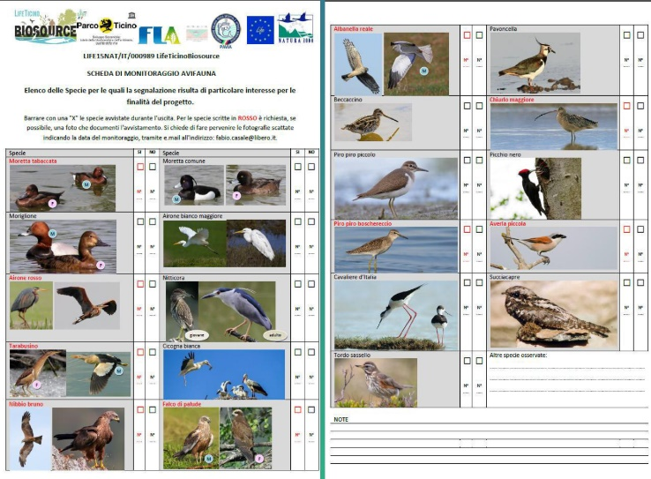
E.2 – Sub-action E2.1 – Training of the task force involved in action C7
The target audience is the volunteer task force group.
Objectives
To train volunteers members of the task force in: - A. naccarii biology and behavior, river ecology and native fish community, IAS effects on the native fish community, biology and ecology of Silurus glanis and its eradication and control; international, national and local regulations related to the task force activity.
Expected results
Task force members trained and ready to perform Action C7. The training has been performed according to the plan.
n.4 theorical lessons took place at Bereguardo, on 23/01/2017 (21 participants); 21/02/2017 (20 participants); 14/03/2017 (15 participants); 28/03/2017 (12 participants). (Presence sheets compiled)
n.6 practical lessons (2 more than expected) took place for 2-3 people each time, on: 23/02/2017; 01/03/2017; 09/03/2017; 16/03/2017; 15/03/2017; 06/06/2017. Participants have been also trained on the completion of a special survey sheet to report the patrols of the task force. Sub-action completed by the end of June 2016.
Deliverables
Description | Foreseen Deadline | Actual deadline
- | - | -

Slide 10
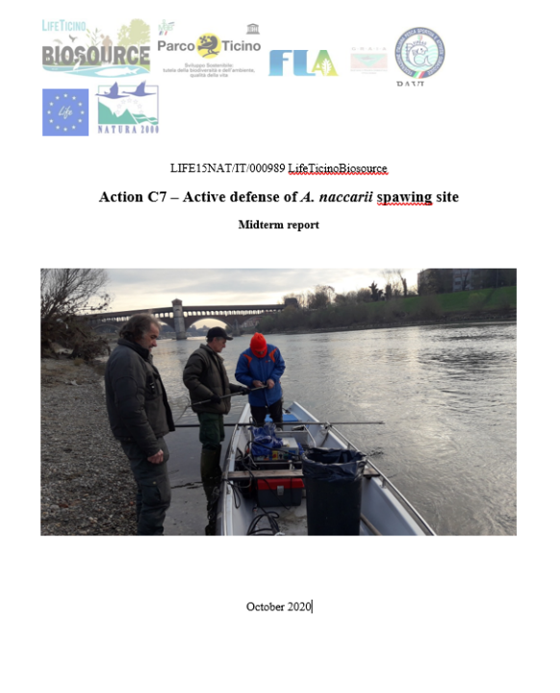
C.7 - Active defense of A. naccarii spawning sites
Objectives
The two main objectives of the action were:
the protection of the natural reproductive sites of A. naccarii from poaching
the control of fish IAS that may represent a significant disturbance to the spawning sturgeons, with special reference to the species Silurus glanis.
Expected results
Poaching discouraged and population of Silurus glanis and its negative effect on the reproduction and growth of A. naccarii reduced.
Milestones
Description | Foreseen Deadline | Actual deadline
Reduction of Silurus glanis presence (in terms of biomass) in the sturgeon spawning area of 50%. | 10/2020 | 10/2020
Deliverables
Description | Foreseen Deadline | Actual deadline
Task force mission report | 10/2020 | 10/2020

Slide 11
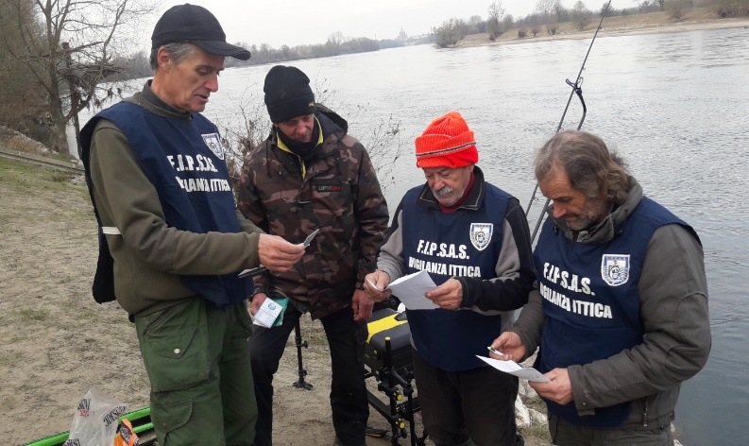
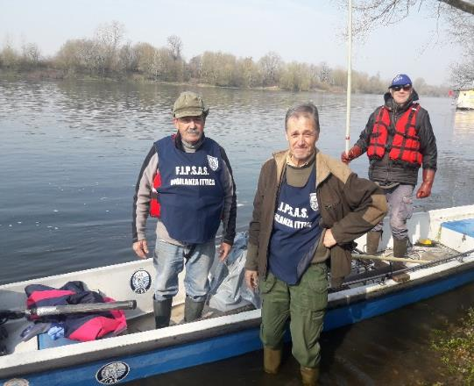
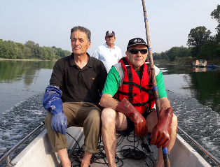
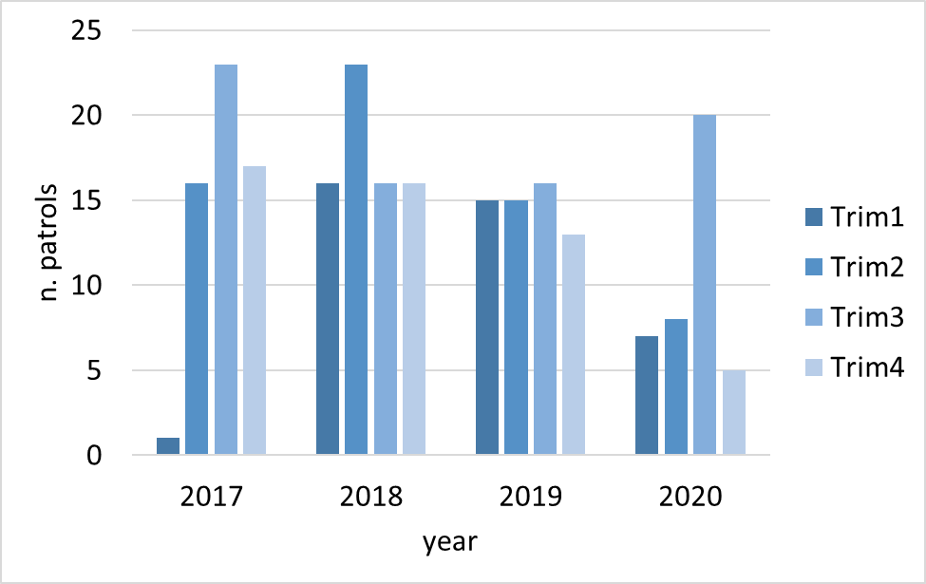
C.7 - Active defense of A. naccarii spawning sites
Action performed from April 2017 till the end of October 2020
Activities performed:
PATROLS AGAINST POACHING
n. 227 surveillance patrols (lasting 3-5 hours) carried out in the target area (divided in three river stretches) in different moments of the day, in four years (a minimum of n. 90 required)
- Fishing licenses control
- Recognitions on riverside or by boat
- Direct observation of fish species
RESULTS:
NO POACHING ACTIVITY FOUND -> SUCCESS OF THE PATROLS AS DETERRENT FACTOR!
A successful network of information created (with persons attending daily the river)
-> an EARLY WARNING NETWORK SYSTEM CREATED BY THE TASK-FORCE for signalling the presence of A. naccarii.

Slide 12
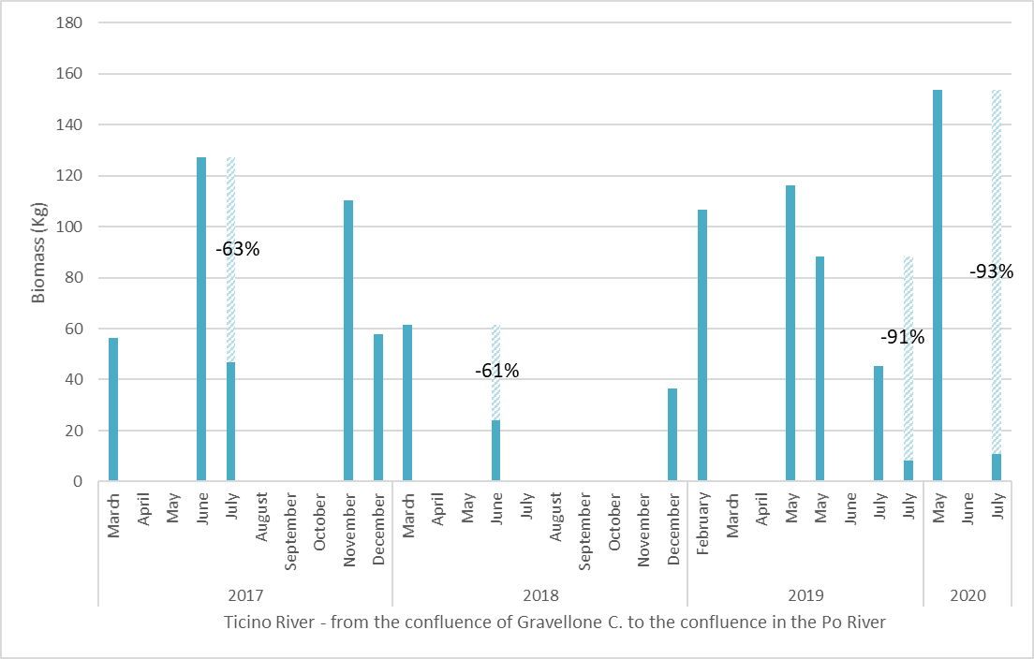
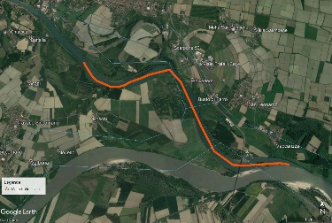
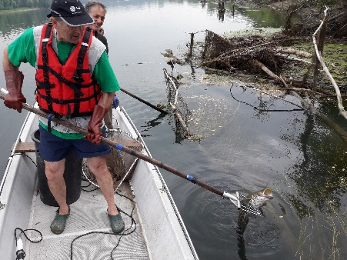
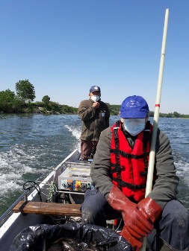
C.7 - Active defense of A. naccarii spawning sites
2. Control of Silurus glanis
n. 42 electrofishing campaigns performed
RESULTS:
3.3 tonnes S. glanis removed from the river
More than 50% reduction of S. glanis in a seasonal key.
Greater efficacy after a stronger action in winter-spring.
Need of a periodic control action, due to the inevitable recolonization of the stretch by the species.
Site | N. Campaigns | N. Specimens | Biomass (Kg)
Monte Ponte Coperto di Pavia | 10 | 525 | 490
Ponte Coperto-Foce Gravellone vecchio | 21 | 890 | 884
Foce Gravellone vecchio-Confluenza Po | 5 | 1915 | 1047
Naviglio Pavese | 2 | 143 | 578
Lanca del Lido | 2 | 7 | 51
Roggia Castellana | 2 | 37 | 250
TOTAL | 42 | 3,517 | 3,300

Slide 13
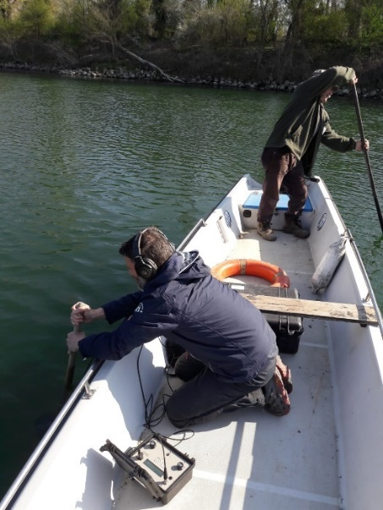
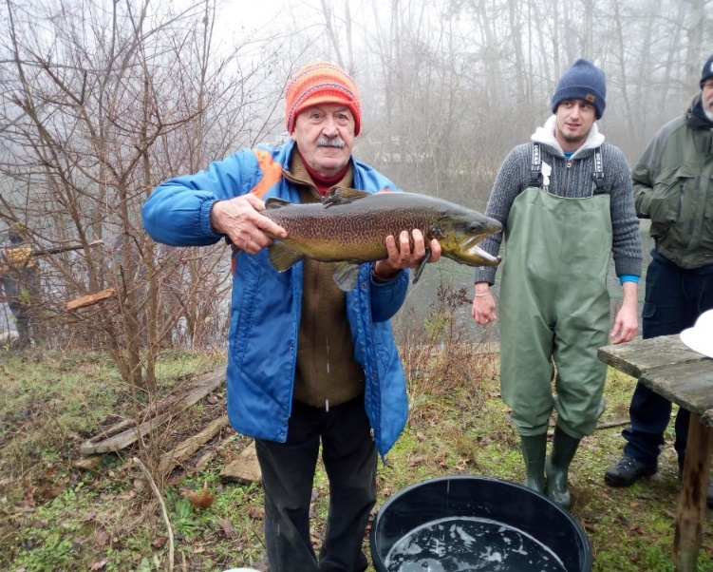
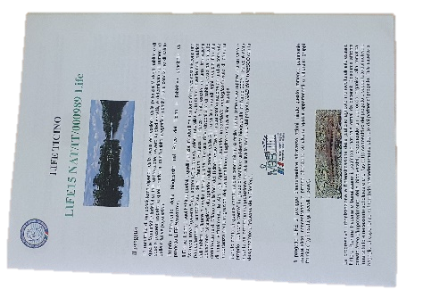
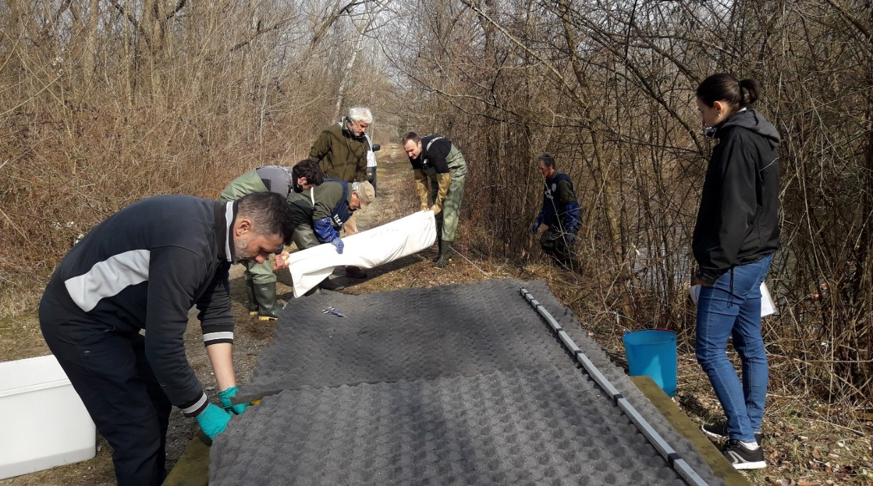
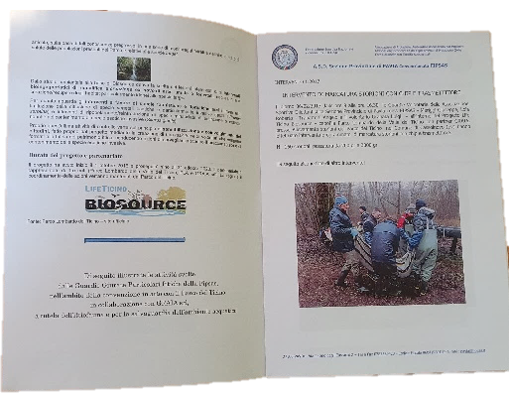
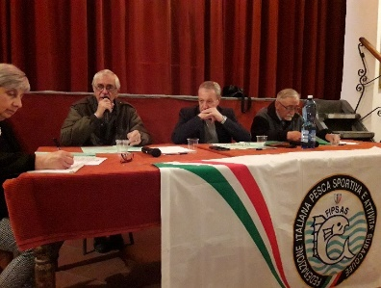
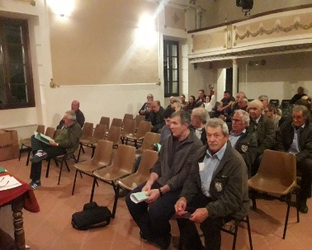
C.7 - Active defense of A. naccarii spawning sites
Other crucial activities carried out by the members of the task-force:
Operative and logistic support to GRAIA and TicinoPark within other actions:
  D7 – telemetry (positioning and survaillance on the fixed hydrophone)
  D7 – marking fishes
Operative and logistic support to TicinoPark for other fish conservation initiatives, extra LIFE (A. naccarii, Salmo marmoratus,… artificial reproduction)
Communication and raising awarness of anglers (seminars on LIFE Project and booklet)

Slide 14
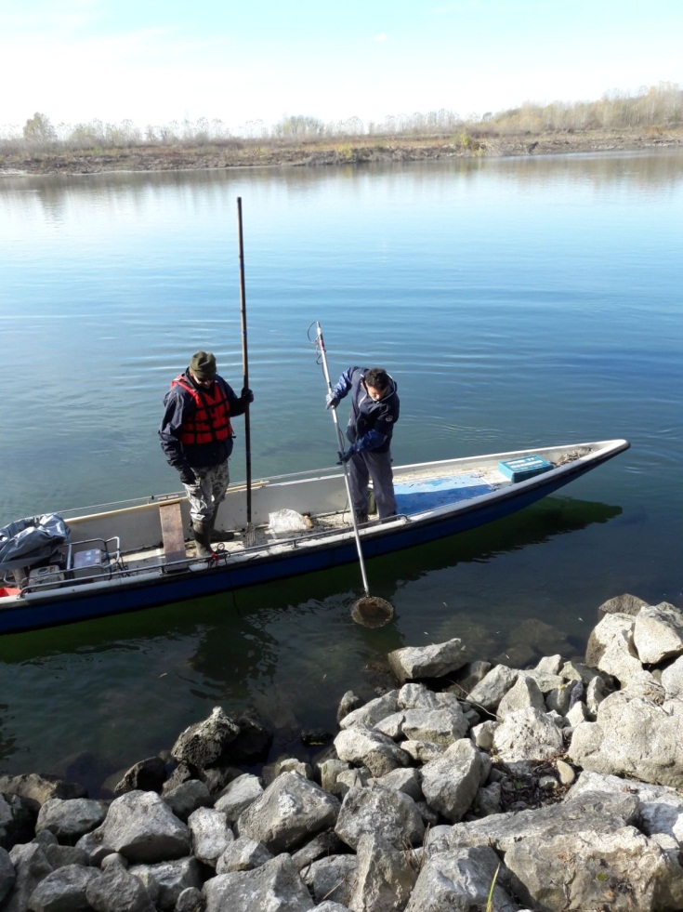
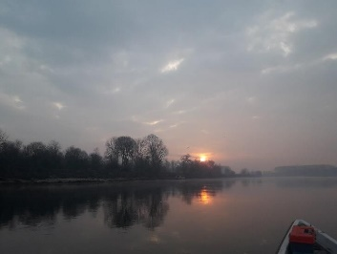
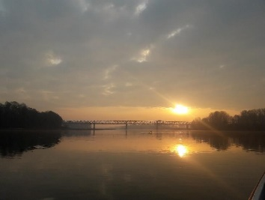
D.6 - Monitoring the efficacy of action C.7
Objectives
The main objective is to assess the impact of C.7 action in terms of:
Pressure on Sturgeons from poaching and S. glanis, in particular in the reproductive period, relieved
Pressure on the whole fish community in the same river stretch relieved
Expected results
Greater presence and better distribution of Sturgeons and other native fish species in the river stretch targeted
An effective feedback on C7 action, useful for adjustements
Deliverables
Description | Foreseen Deadline | Actual deadline
Monitoring progress and final reports | 10/2020 | 10/2020

Slide 15
D.6 - Monitoring the efficacy of action C.7
D.6 - Monitoring the efficacy of action C.7
Monitoring activity has been performed in two ways:
Electrofishing by day
Nocturnal direct observations
RESULTS
n. 21 electrofishing sessions carried out by day (a minimum of 12 foreseen)
- 18 Native species found
- 7 of Community interest
- 15 Alien species
- 2 wild sturgeons in REPRODUCTIVE PERIOD (detected from the boat, not sampled)
Species richness seems enhancing in the last years.

Slide 16
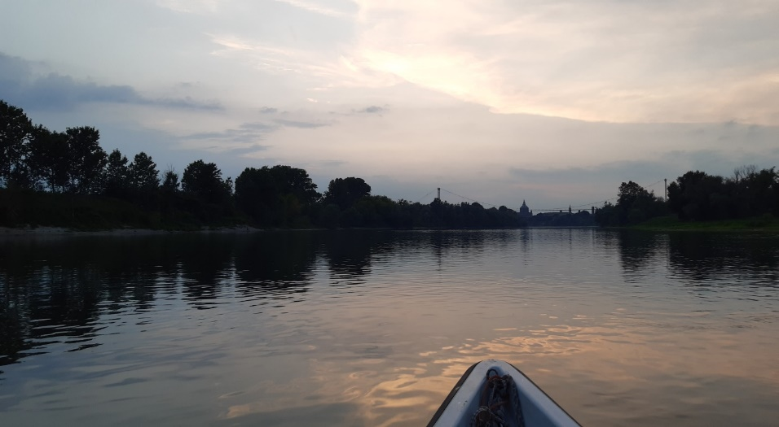
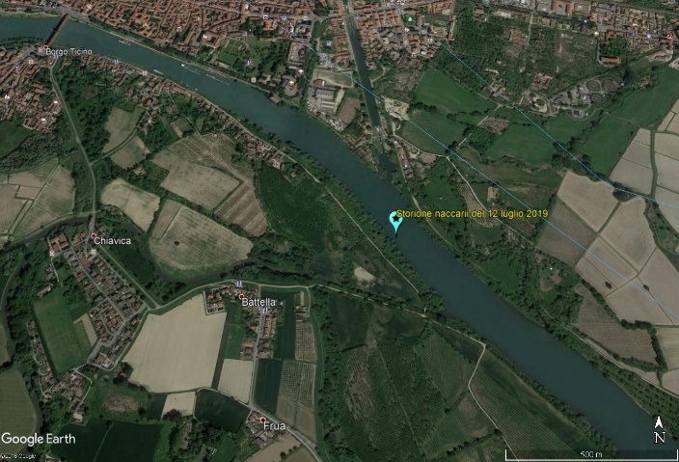
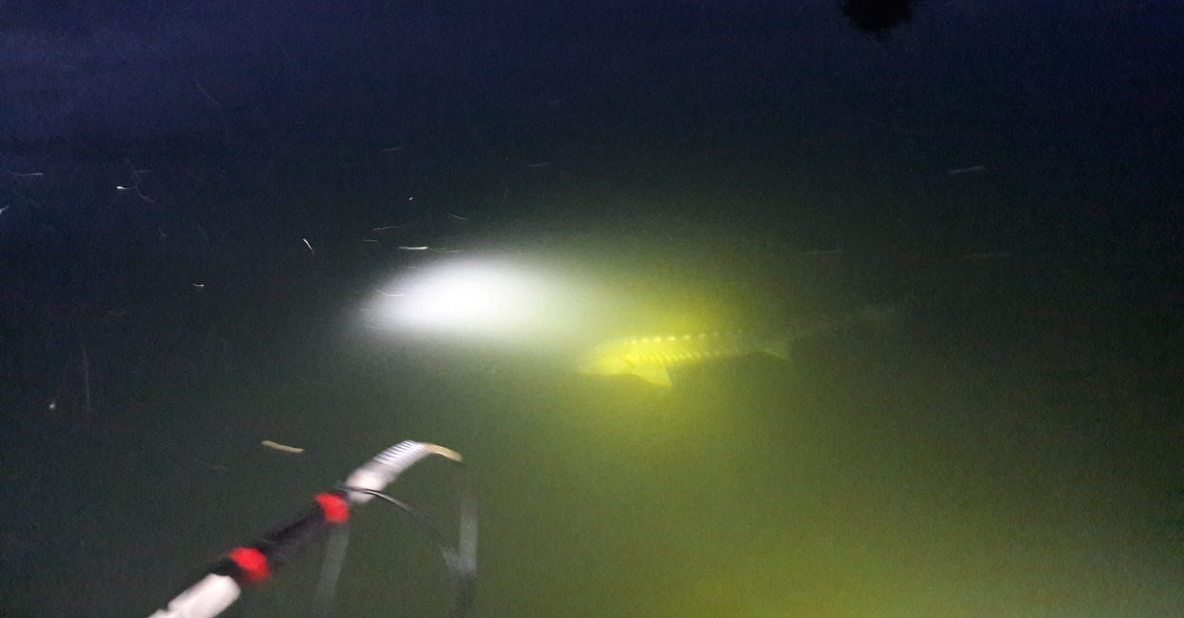
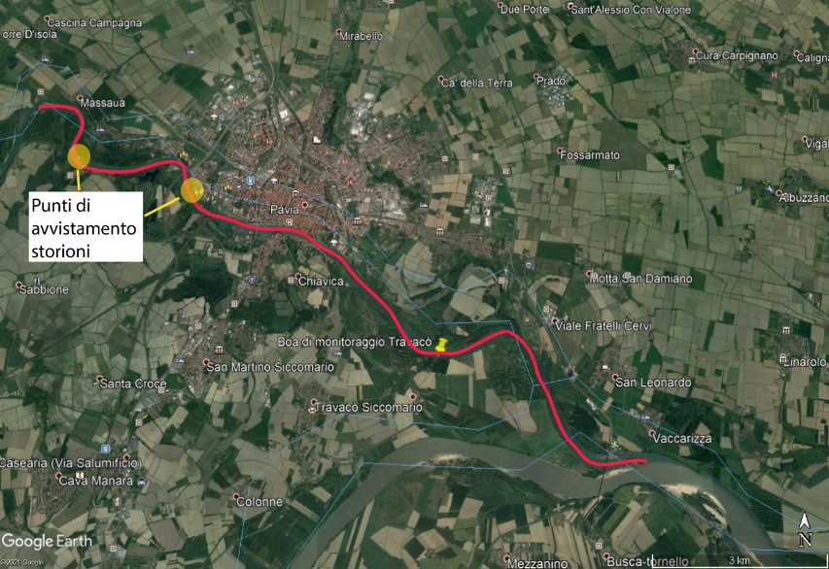
D.6 - Monitoring the efficacy of action C.7
D.6 - Monitoring the efficacy of action C.7
n. 14 nocturnal direct observation by boat performed in reproductive period
  Critical conditions due to water high turbidity
  N.1 adult sturgeon detected in July 2019
  N. 3 adult sturgeons detected in July 2020
3 sturgeons detected on 10th and 13th July 2020

Slide 17
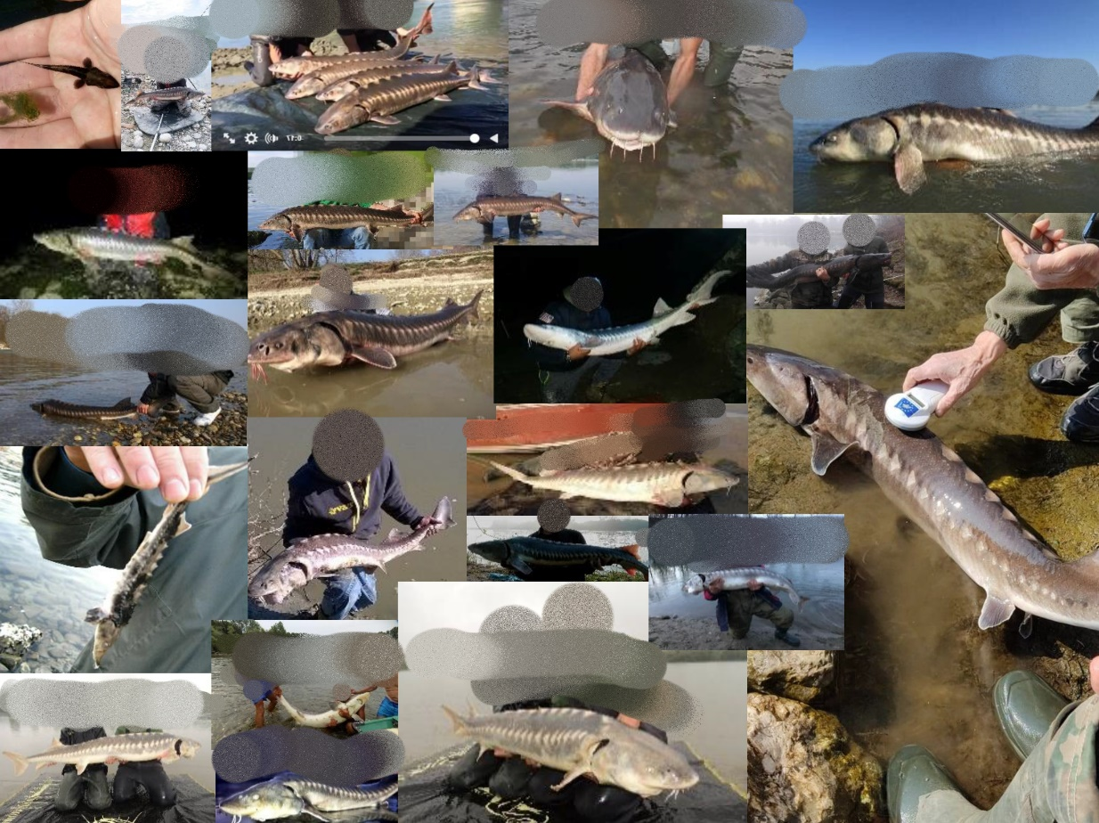
D.6 - Monitoring the efficacy of action C.7
D.6 - Monitoring the efficacy of action C.7
- Thanks to the early warning system spontaneously created with anglers, during the project we had 52 reports about A. naccarii sightings or captures, some of which documented with photos.
River | Anno | Adulto | Giovanile
Ticino River and its network | 2017 | 5 | 1
 | 2018 | 5
 | 2020 | 6 | 1
 | 2021 | 3
Canale Villoresi | 2018 | 1
 | 2020 | 1
Naviglio Pavese | 2018 | 1
Po River | 2016 | 4
 | 2017 | 9
 | 2018 | 9
 | 2019 |  | 1
 | 2021 | 1
Adda River | 2018 | 4

Slide 18
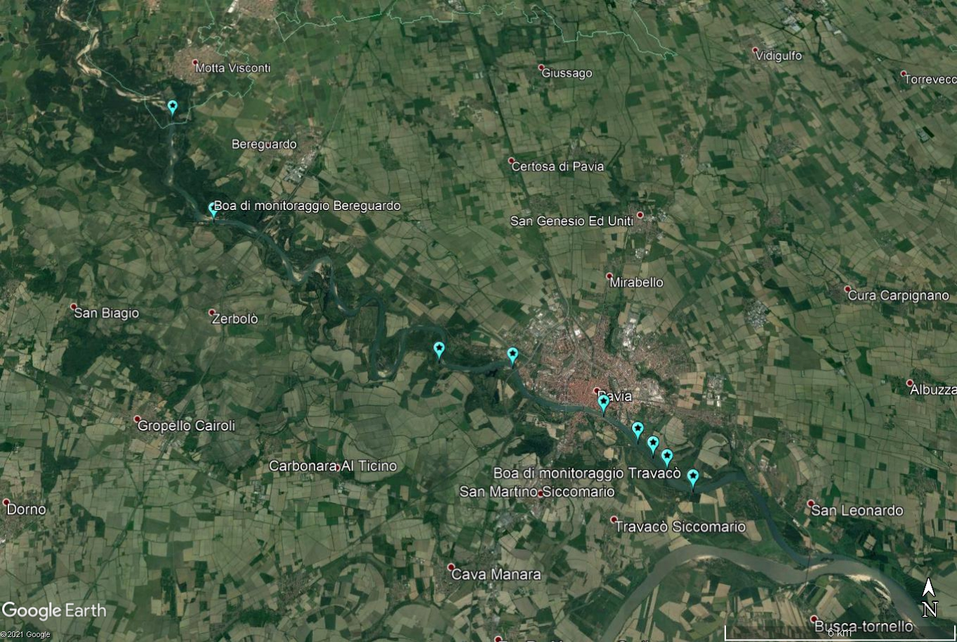
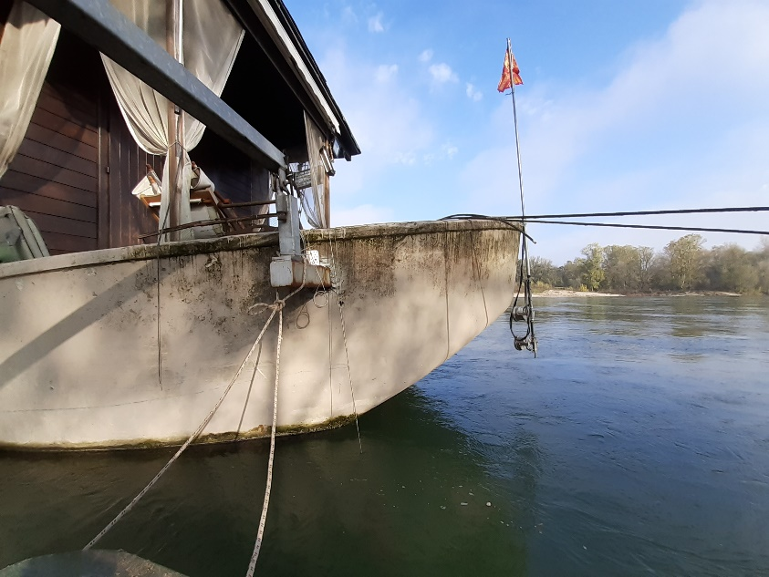
D.6 - Monitoring the efficacy of action C.7
D.6 - Monitoring the efficacy of action C.7
Through biotelemetry performed in Action D7, 10 sturgeons of the species A. naccarii, released in the wild with transponder during LIFE project Con.Flu.Po (2012-2018) have been detected again by mobile and fixed acoustic hydrophones.
Transmitter Code | 2019 | 2020 | Total
11567 |  | 1 | 1
11574 |  | 1 | 1
11582 | 1 |  | 1
11599 |  | 1 | 1
11601 | 1 | 1 | 2
11607 | 15 | 1 | 16
11618 | 7 |  | 7
11631 | 1 |  | 1
11633 |  | 1 | 1
11636 |  | 1 | 1
Total sightings | 25 | 7 | 32

Slide 19
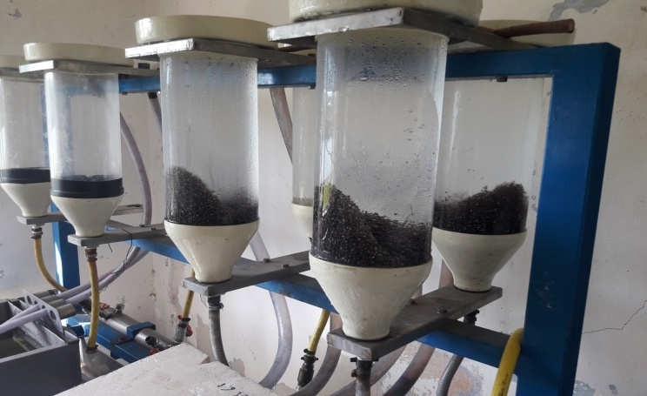


Ongoing activities on A. naccarii after LIFE Con.Flu.Po
A. naccarii breeding at Ticino Park plants
Broodstock – male individuals (artificially induced/reproduced) | 9/9
Broodstock – female individuals (artificially induced/reproduced) | 10/5
Volume of eggs produced (liters) | 8
Number of larvae (estimated) | 160.000
Number of juveniles produced (October 2020 - estimated) | 8.000

